Slide 1


Modern Control Theory
Lecture No. 11
Extending the Observer Concept to a Kalman Filter
Conceptualizing Uncertainties in State Space Models
Introducing Gaussian Prob. Density Function and the Underlying Statistics
Conceptualizing the Formulation of a Kalman Filter

Slide 2
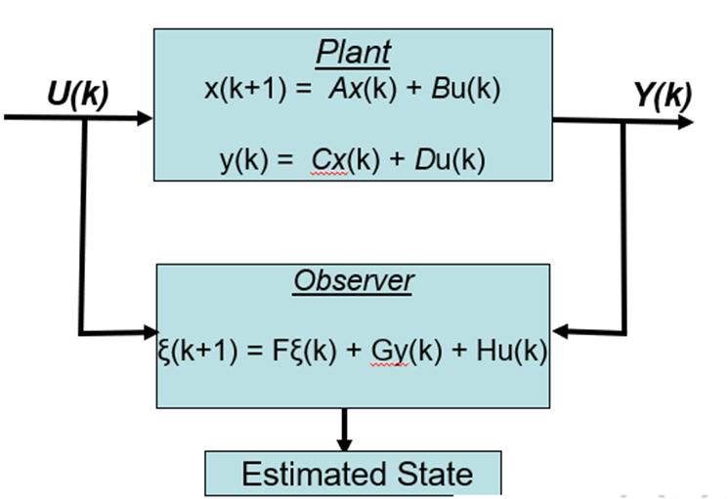
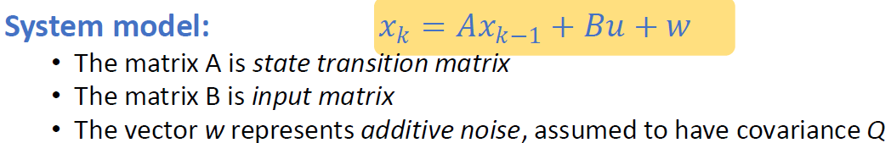
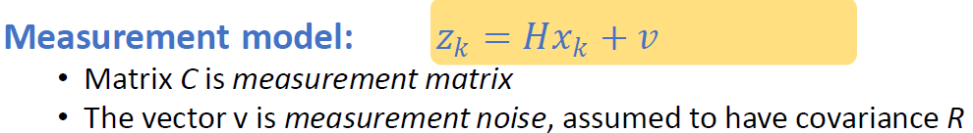
Extending the Observer Concept to a Kalman Filter
Uncertainties in Process Models/State Equations
Uncertainties/Noise in Measurements

Slide 3
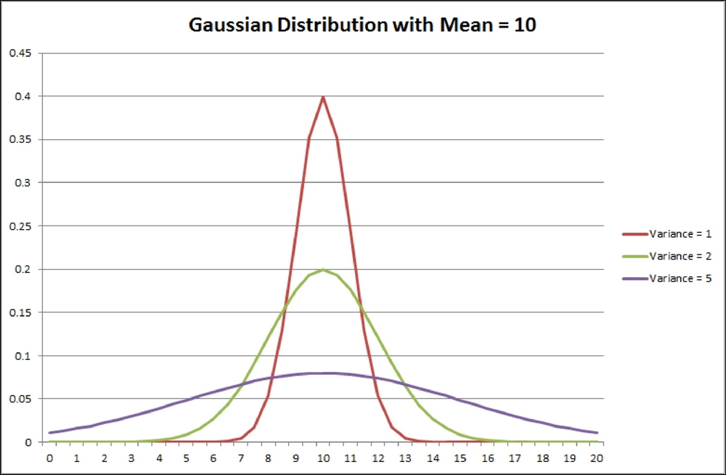
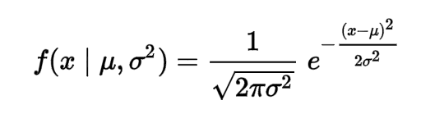
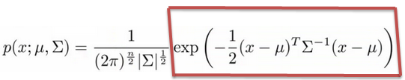
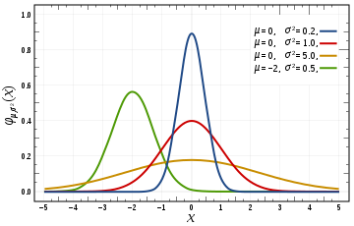
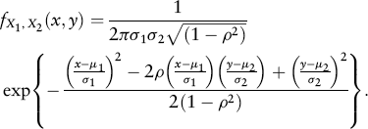
Gaussian Distribution

Slide 4
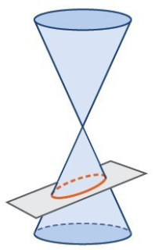
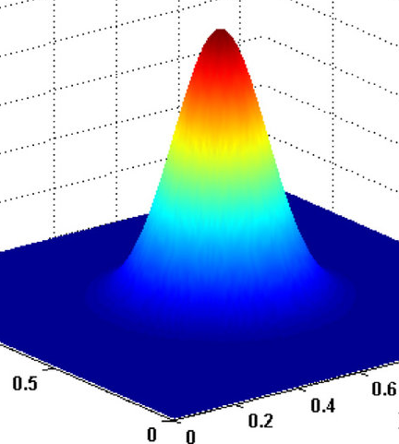
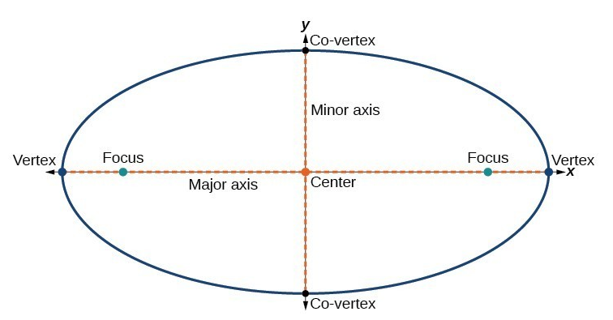
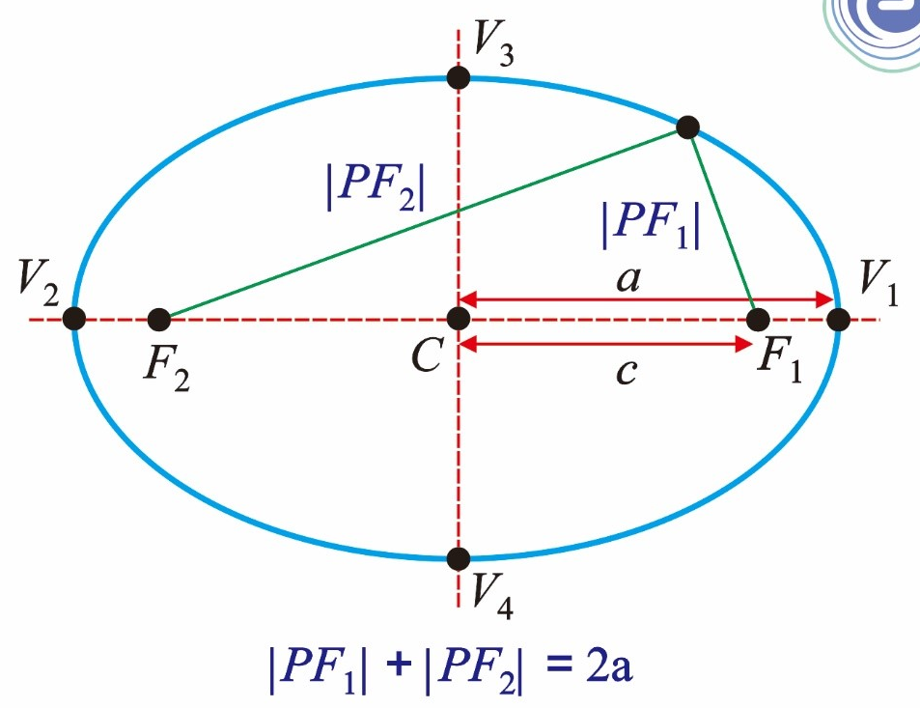
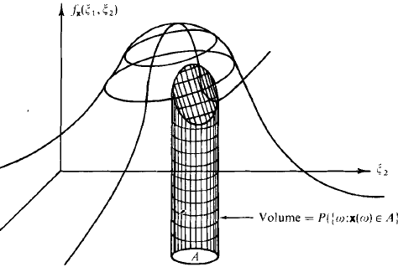
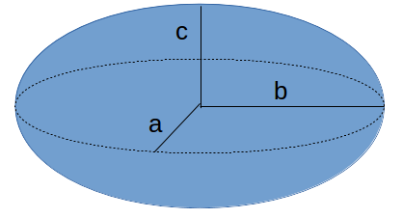
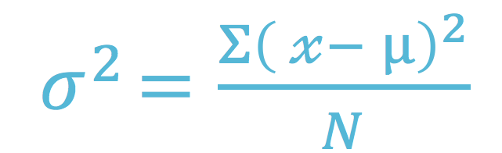
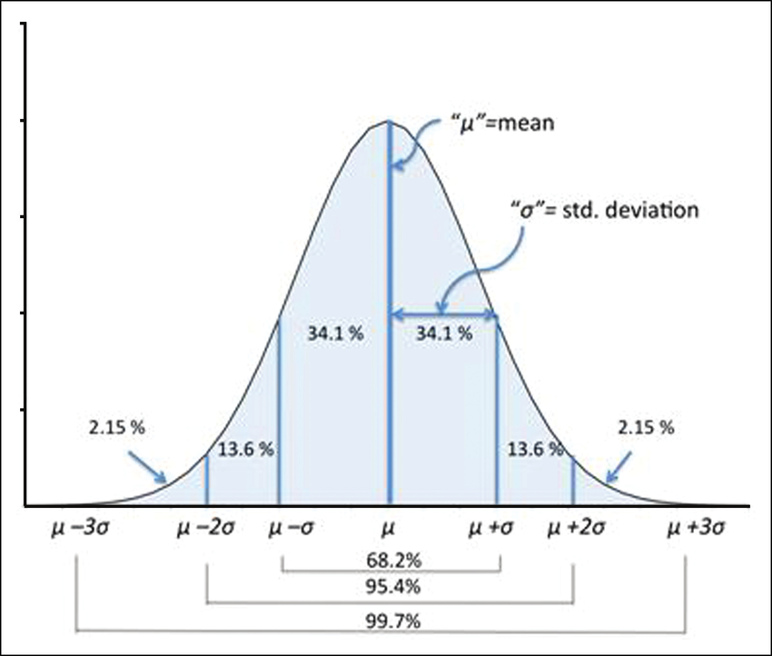
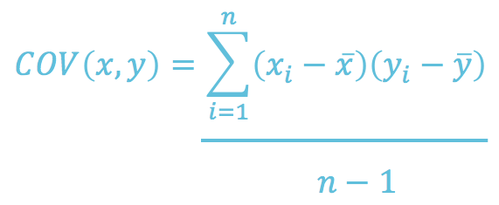
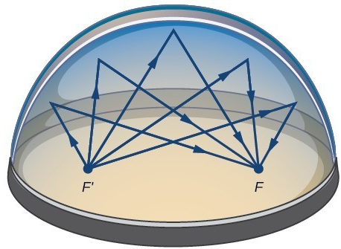
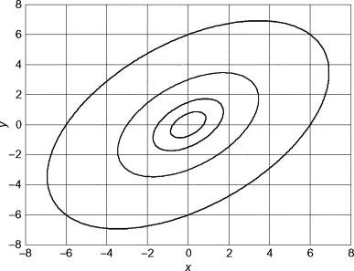
Ellipsoid as a Measure of Gaussian Uncertainty

Slide 5
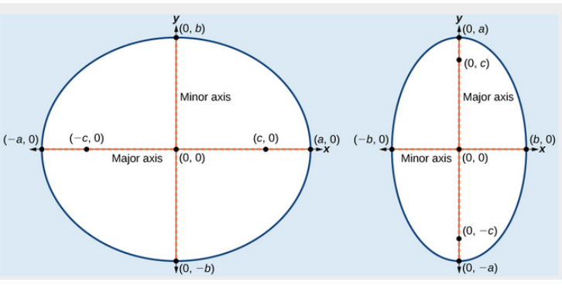
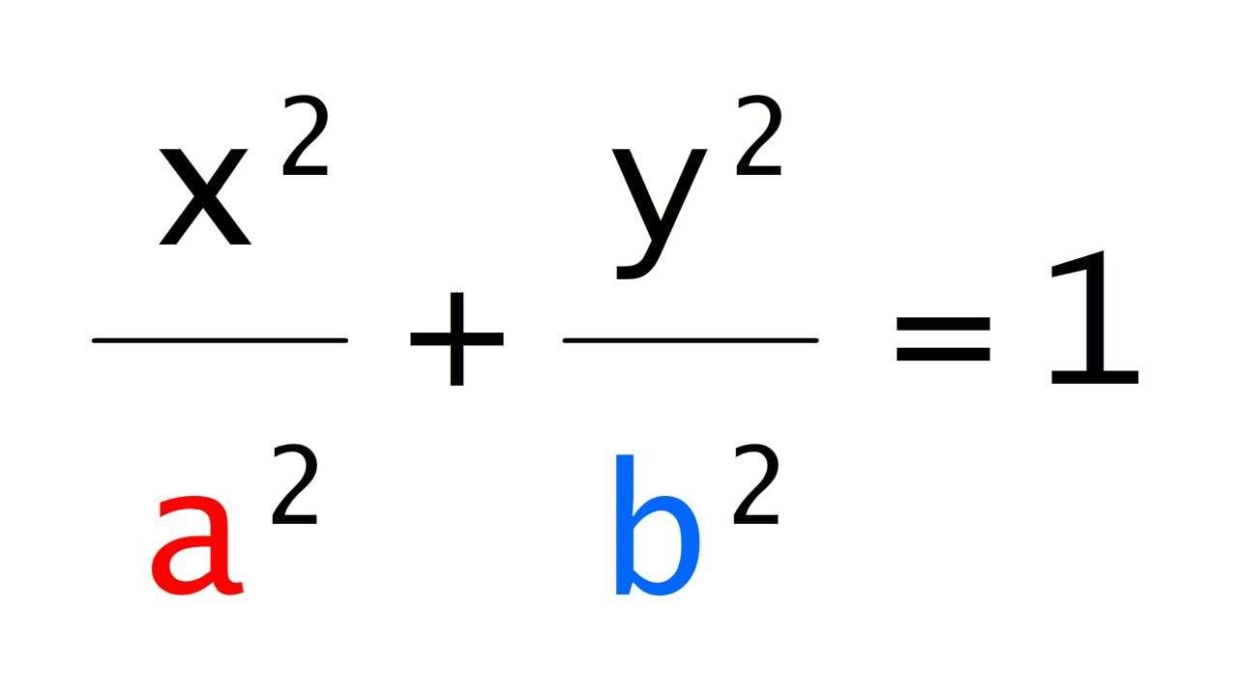
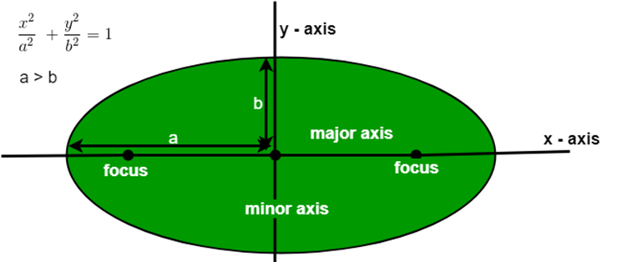
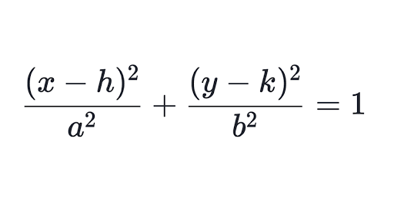
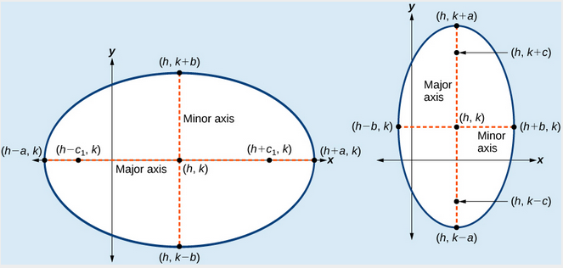
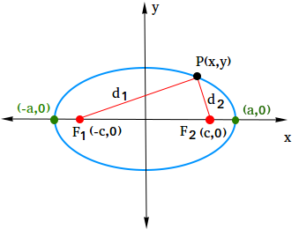
Further Insight of the Ellipse

Slide 6

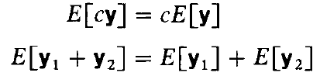
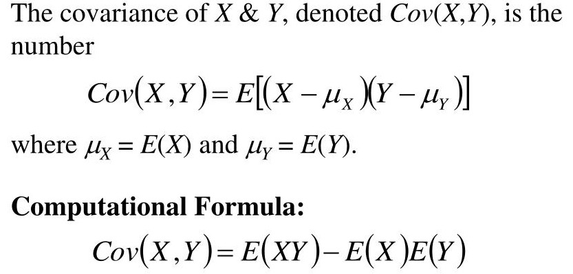
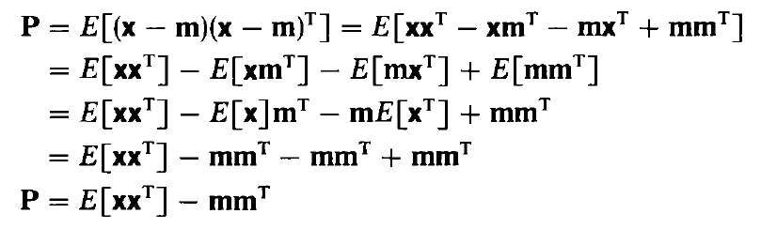

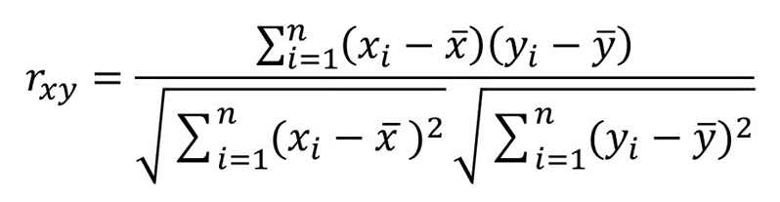
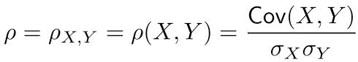
The Statistical Moments

Slide 7
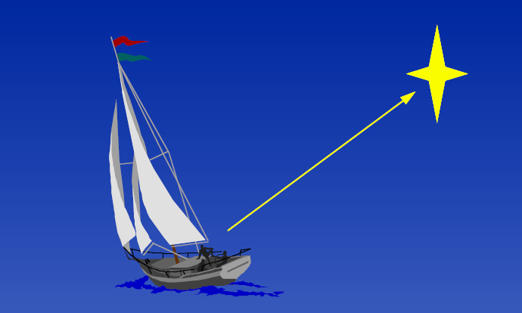
Navigating --- Propagating a Conditional PDF?
Say, you are lost in sea. However, you have some idea on obtaining directions from the pole-star
Obtain a measurement

Slide 8
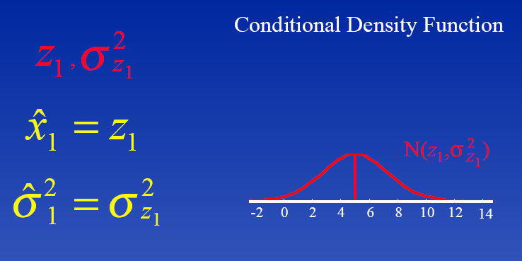
Asess the Measurement
The measurement may not be exact
It would have a mean and a variance

Slide 9
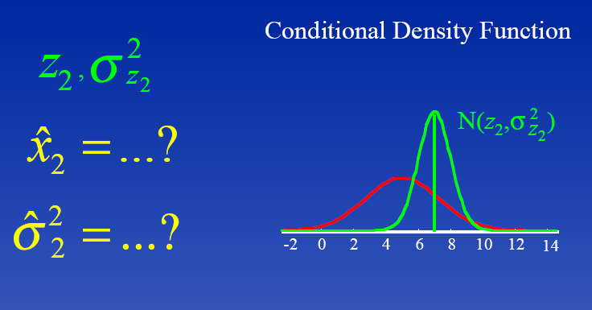
Update the Previous Measurement
Now, let’s say your friend is better in navigating
He takes a second measurement --- more accurate ?
Even this would have a mean and variance, but possibly
the variance would be smaller – he has more expertise

Slide 10
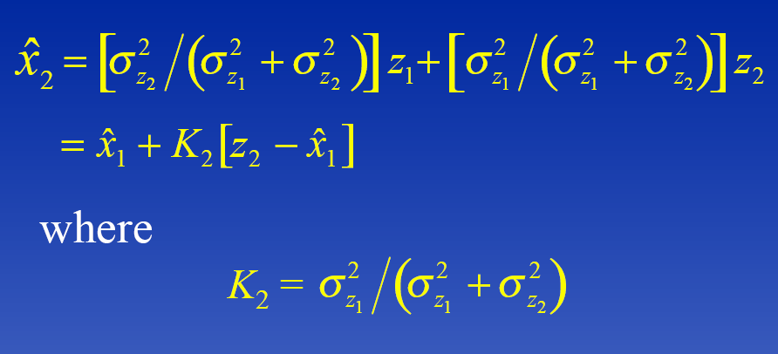
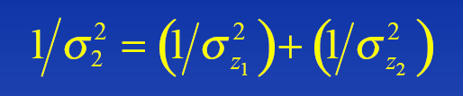
Assess the Results of Two Measurements
Now combining the variances, we obtain

Slide 11
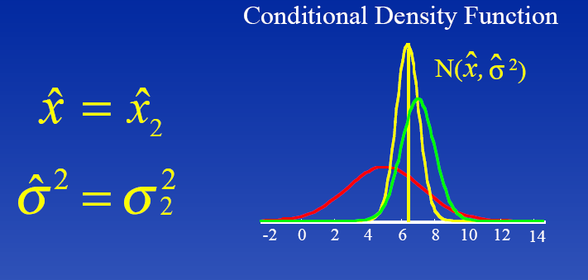
Result
The result is an improved idea as to how much away you are from the coast
Are we propagating a conditional density function and each time updating it with the latest measurement ?

Slide 12
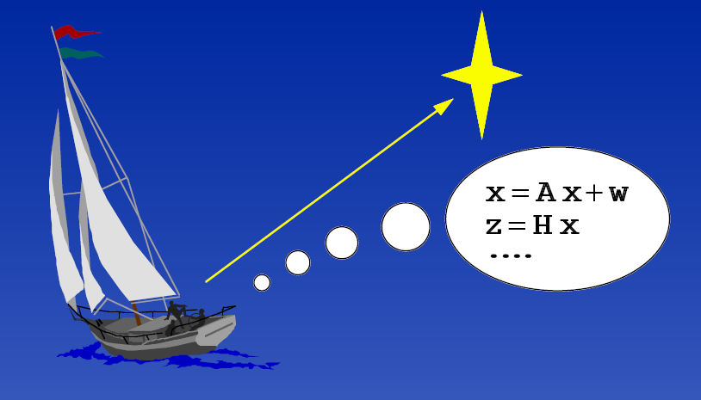
Adding Dynamics
Velocity of the Boat, dx/dt = v + w
Uncertainties (w)--- tide-drag, wind-speed, etc.

Slide 13
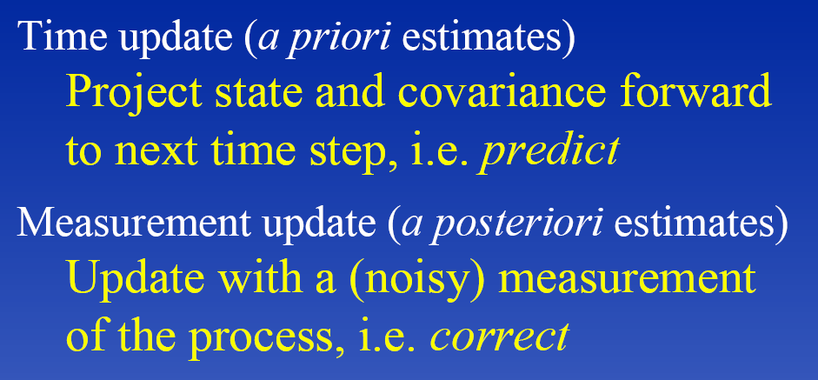
In effect the boat-people were doing thus

Slide 14
Thus

Slide 15
